Slide 1


MASTER-ACADEMY
Configuration Management With Ansible
Week 4
DevOps Boot Camp 2021

Slide 2
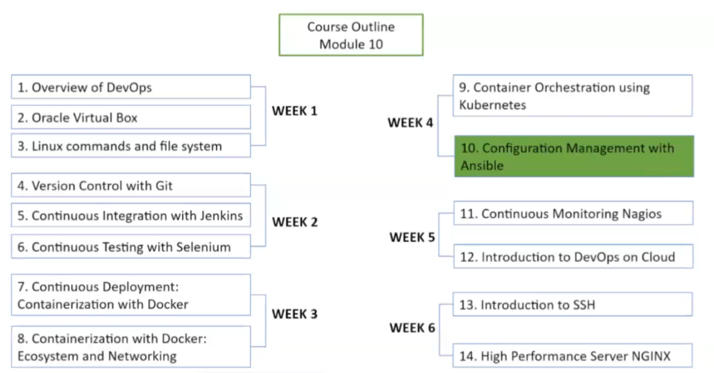
MASTER-ACADEMY
DevOps Boot Camp 2021

Slide 3
Topics
MASTER-ACADEMY
Introduction to Ansible
Ansible Architecture
Setting up Ansible
Ad-hoc commands in Ansible
Ansible Playbook
Roles in Ansible
Variables in Ansible
Deploy a Docker Container
DevOps Boot Camp 2021

Slide 4
Objective
MASTER-ACADEMY
Upon completion of this module, you should be able to:
Install Ansible on your machine
Understand Ansible architecture
Write Ansible playbooks
Execute different ad-hoc commands using Ansible
Implement a project using Ansible
DevOps Boot Camp 2021

Slide 5
What is a Configuration Management System?
MASTER-ACADEMY
Configuration management is systems engineering process for establishing consistency of a product’s attributes throughout its life
In the technology world, configuration management is an IT management process that tracks individual configuration items of an IT system. An IT asset may represent a piece of software, or a server, ora cluster of servers.
DevOps Boot Camp 2021

Slide 6
Why is configuration management important?
MASTER-ACADEMY
Configuration management helps engineering teams build robust and stable systems through the use of tools and automatically manage and monitor updates to configuration data.
When managing hundreds or thousands of servers consisting of different types, groups and flavours, its is essential to maintain the consistency of their respective environments.
It is extremely difficult, inaccurate, expensive and time consuming to maintain the state of the servers individually. However collectively with the use of a Configuration management tool it is easy to maintain a healthy state of all servers.
DevOps Boot Camp 2021

Slide 7
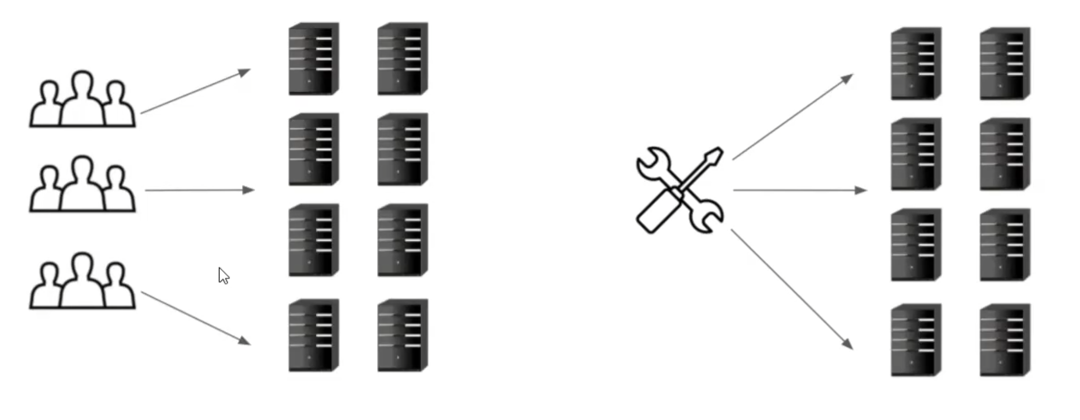
Configuration Management
MASTER-ACADEMY
DevOps Boot Camp 2021

Slide 8
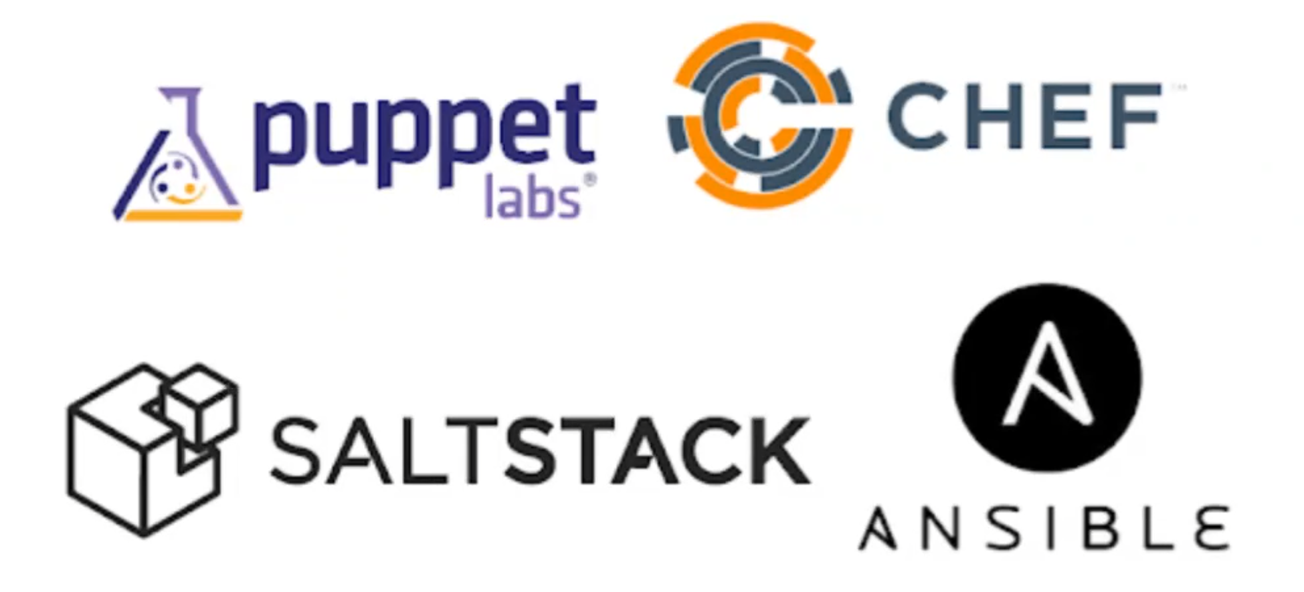
Configuration Management Tools
MASTER-ACADEMY
DevOps Boot Camp 2021

Slide 9
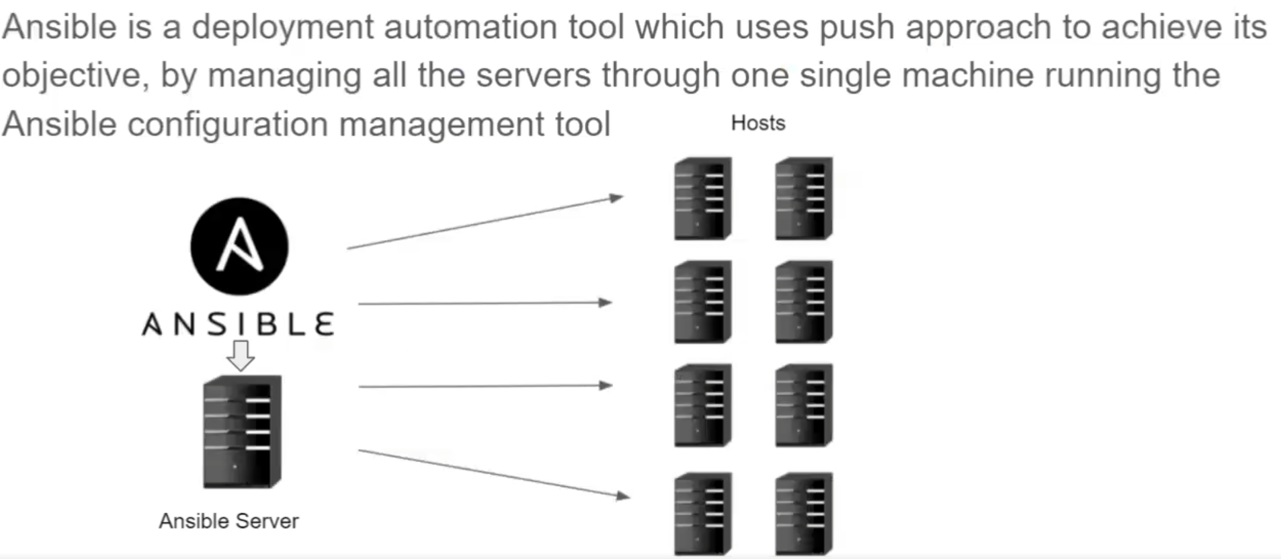
What is Ansible
MASTER-ACADEMY
DevOps Boot Camp 2021

Slide 10
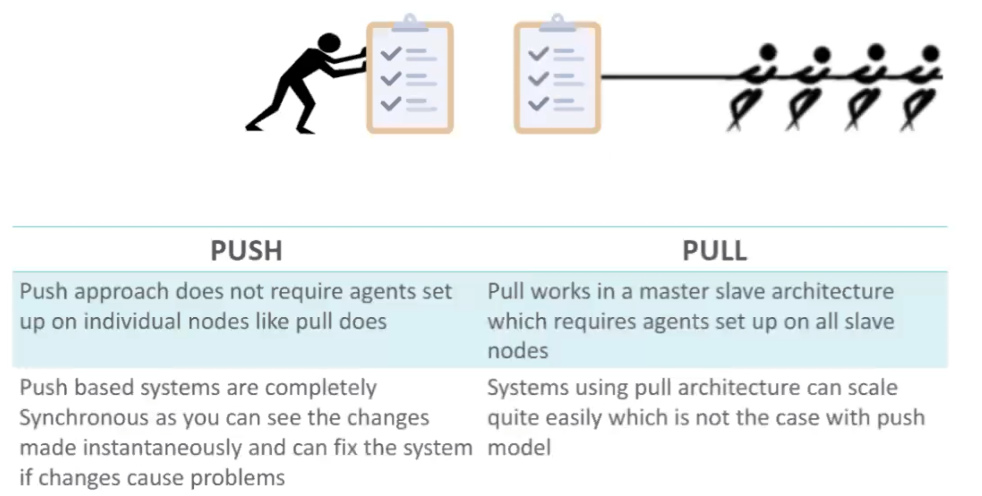
How is Push different from Pull Approach
MASTER-ACADEMY
DevOps Boot Camp 2021

Slide 11
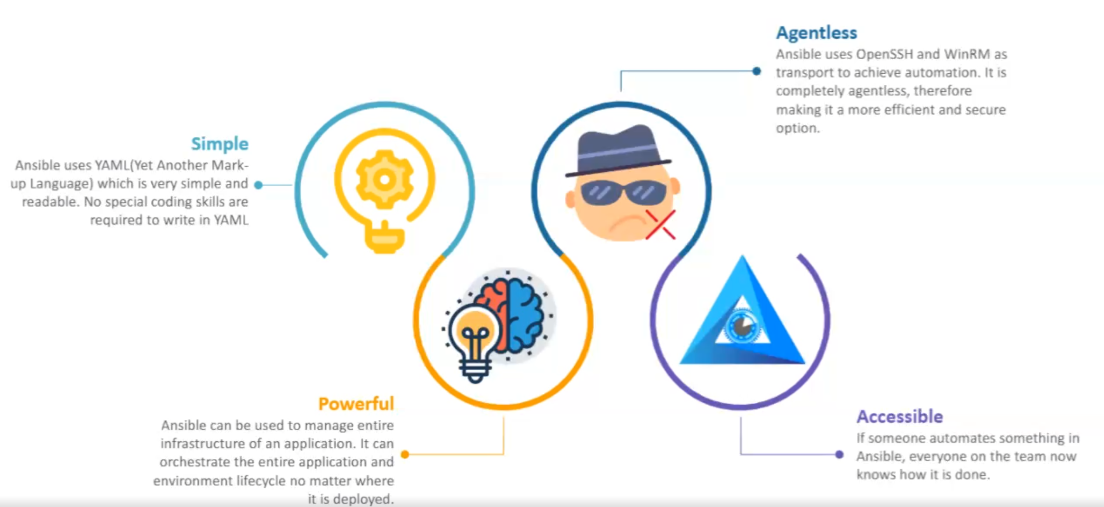
Why Ansible
MASTER-ACADEMY
DevOps Boot Camp 2021

Slide 12
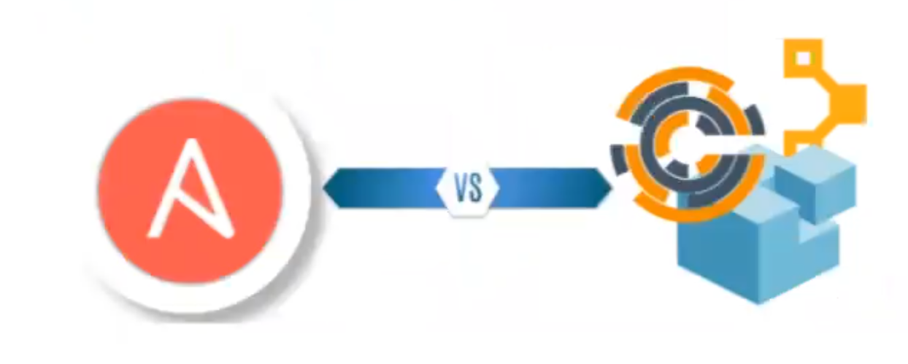
Ansible Vs Other Tools
MASTER-ACADEMY
Ansible is much easier to work with compared to other tools like Chef, Puppet and Saltstack
Ansible does not require Agent to be setup on individual hosts or nodes
Ansible is simple enough for new users and integrates with other tools
Ansible also support pull architecture if required
DevOps Boot Camp 2021

Slide 13
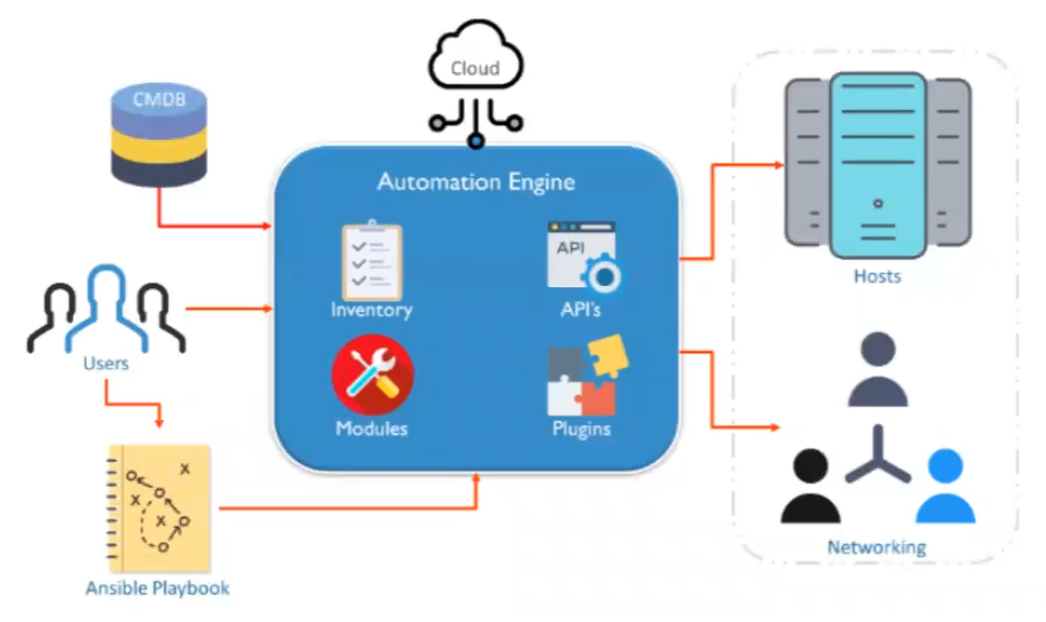
Ansible Architecture
MASTER-ACADEMY
Ansible connects to the nodes and pushes out small programs called “Modules”. These modules bring the system to the desirable state. Ansible uses SSH to execute these modules and then removes them when finished
DevOps Boot Camp 2021

Slide 14
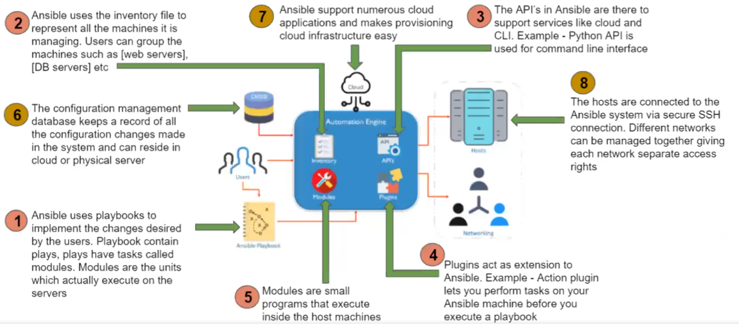
Architecture Components
MASTER-ACADEMY
DevOps Boot Camp 2021

Slide 15
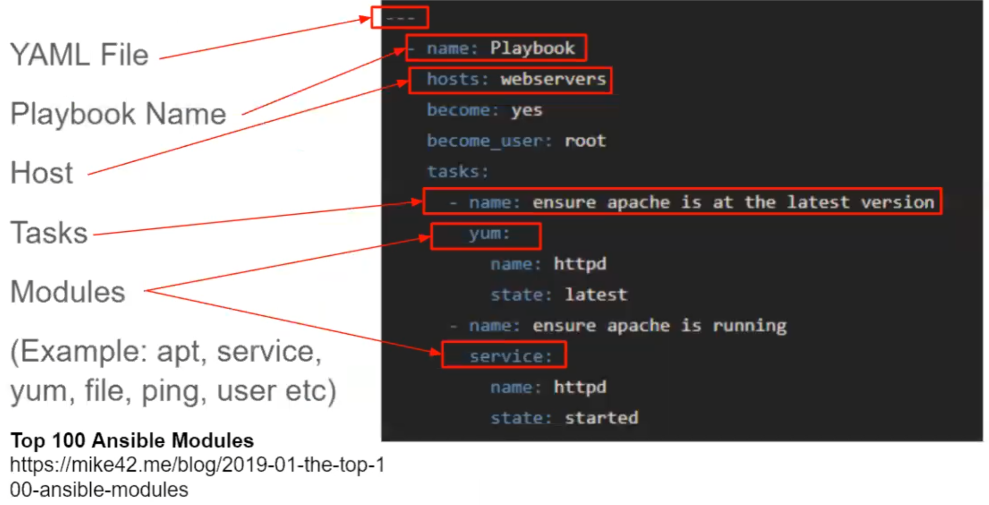
Ansible Playbook
MASTER-ACADEMY
DevOps Boot Camp 2021

Slide 16
Installing Ansible
MASTER-ACADEMY
Spin up 3 EC2 (Ubuntu 20.x) instances if using AWS or create 3 VMs using Oracle VM Box and connect to your machines
Name your VMs as AnsibeServer, Host1 and Host2
Login to all machines and change to root user: sudo -i
Run command apt-get update
On your AnsibleServer install Ansible:
apt-get install ansible
Next need to configure password less SSH:
First need to create a SSH key pair on AnsibleMaster: ssh-keygen (press enter for all options)
To copy the public key type command: cat .ssh/id_rsa.pub and select the key to copy
In all the host nodes type command: vim .ssh/authorized_key and paste by right clicking
From AnsibleServer ssh to all nodes once and then login: ssh xx.xx.xx.xx
DevOps Boot Camp 2021

Slide 17
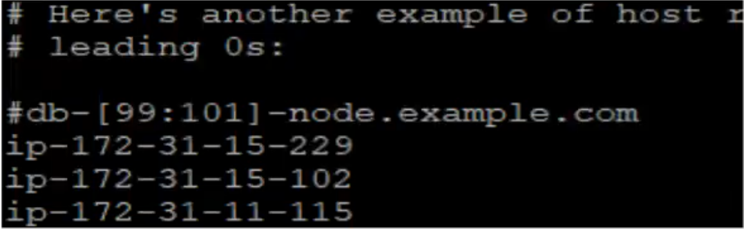
Configure Host File
MASTER-ACADEMY
As root user the host file is under /etc/ansible/hosts
Now you can edit and save the file using vim
vim /etc/ansible/hosts
Copy and paste the IP address of the hosts at the bottom of the file in this format and save and exit vim
ip-172-31-11-115
DevOps Boot Camp 2021

Slide 18
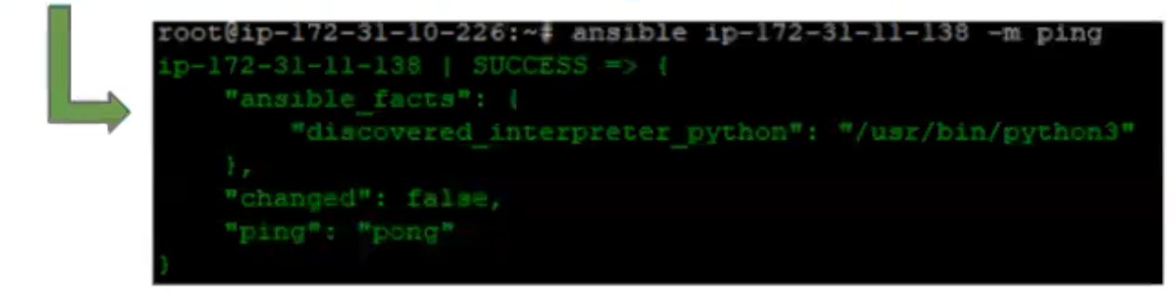
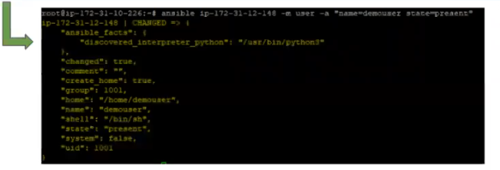
Ad-hoc Commands & Modules in Ansible
MASTER-ACADEMY
Example 1: Use the ping module to check if a host can be pinged
ansible ip-172-31-11-115 -m ping
Example 2: Create a new user by using the user module
ansible ip-172-31-12-148 -m user -a “name=demouser state=present”
DevOps Boot Camp 2021

Slide 19
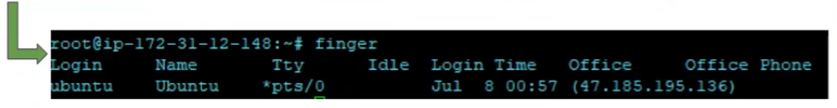
Ad-hoc Commands & Modules in Ansible (cont)
MASTER-ACADEMY
Check if demouser has been created in host
id demouser
Install a package on the host machine using apt module
ansible ip-172-31-12-148 -m apt -a “name=finger state=present update_cache=true”
Check on the host machine if finger was installed by typing finger
To run a module on all the hosts use “all” instead of IP address
ansible all -m apt -a “name=finger state=present update_cache=true”
Google list of all Ansible modules
DevOps Boot Camp 2021

Slide 20
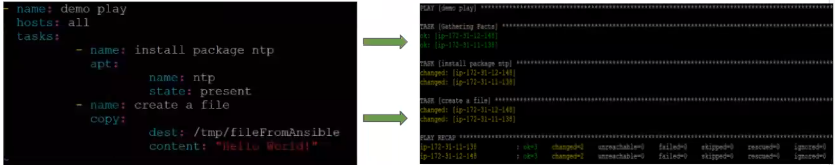
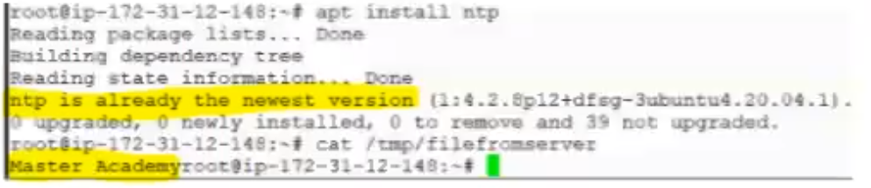
Create and Execute a Playbook
MASTER-ACADEMY
Change directory to /etc/ansible: cd /etc/ansible
Use vim editor to write a playbook: vim demoplaybook.yaml
Type this command to execute the play: ansible-playbook demoplaybook.yaml
Check host for changes
DevOps Boot Camp 2021

Slide 21
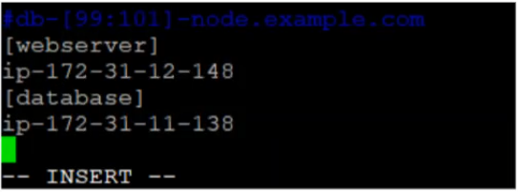
Grouping Inventory
MASTER-ACADEMY
Grouping of inventory is a general practice to isolate hosts or machines into different categories. If we have 100s of hosts we can group them as webserver, database etc. Grouping allows Ansible to push different configurations to different types of hosts in production environment
Inside the inventory file (/etc/ansible/hosts) host machines can be grouped
vim /etc/ansible/hosts
Type [webserver] & [database]: follow the example below
DevOps Boot Camp 2021

Slide 22
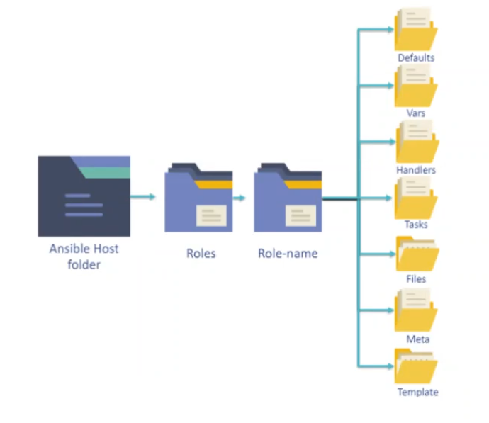
Ansible Roles
MASTER-ACADEMY
Overtime working with Ansible a user may create hundreds of playbooks, variables, templates etc. Roles allow users to group this logic into an organized manner making reusability and sharing of Ansible structure easier.
Roles uses directories to structure and group all the playbooks, variables, templates, tasks, handles, files and defaults.
This collected logic can be grouped in any way the user wants, for example you group server specific roles together.
These roles can then be used inside playbooks and even as in-line commands.
DevOps Boot Camp 2021

Slide 23
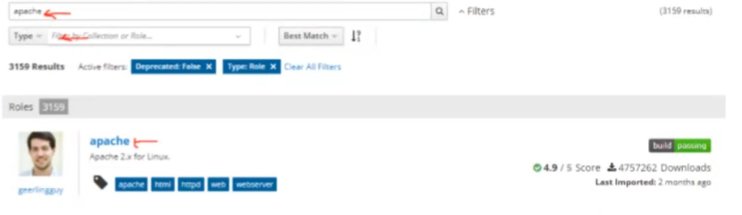
Creating a Role
MASTER-ACADEMY
To create a role a tool called Ansible-galaxy comes installed with ansible.
In order to create a new role it must be initialized, once initialized the folders will be created. The defaults folder contain a file main.yml which contains all the default variables to be used by the role.
For example a requirement has come in to install 10 apache webservers. There could be different types of machines like ubuntu, centos, sues and all of them will require different configurations and setup parameters. You can write a playbook but need to define the logic which can be complicated. This problem can be solved using Roles.
Roles for different tasks (as stated above) can be found on galaxy.ansible.com
Browse to galaxy.ansible.com
Click “Search” and type apache and filter type for roles then click on apache
DevOps Boot Camp 2021

Slide 24
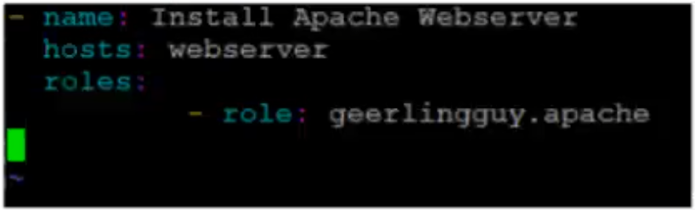
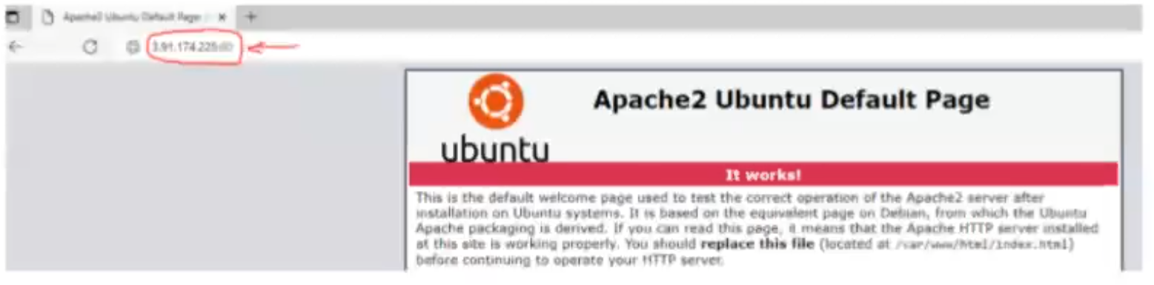
Creating Roles (cont)
MASTER-ACADEMY
Next copy the instruction and run it on your Ansible Server
cd /etc/ansible (change dir to ansible if not already inside)
ansible-galaxy install geerlingguy.apache
cd ~/.ansible/roles/geelingguy.apache/ (after installation go to the folder where role was installed)
Inside this folder type “ll” to list all folders and go inside tasks folder and you find main.yml
Next change directory to /etc/ansible and create a new playbook and only include the installed role
vim apacheRolePlaybook.yaml
ansible-playbook apacheRolePlaybook.yaml
Open browser and type webservrer public IP and port 80
Example: 3.91.174.225:80
DevOps Boot Camp 2021

Slide 25
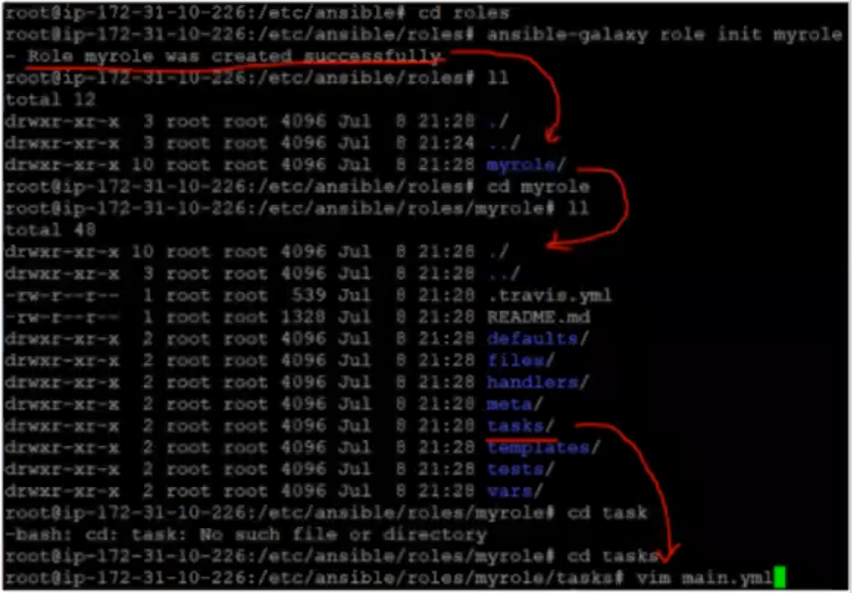

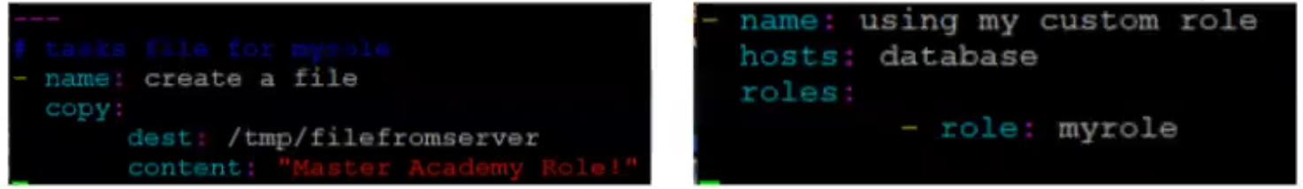
Create Custom Role
MASTER-ACADEMY
It is also possible to create your own role
Make a directory inside /etc/ansible: mkdir roles
Change directory to roles: cd roles
Run command: ansible-galaxy role init myrole
A new directory called myrole will be created
Change directory to myrole and list all folders
Change directory to tasks and open main.yml
Create a task inside main.yml using vim
Now go to /etc/ansible and create new playbook
Run playbook useCustomRole.yaml
DevOps Boot Camp 2021

Slide 26
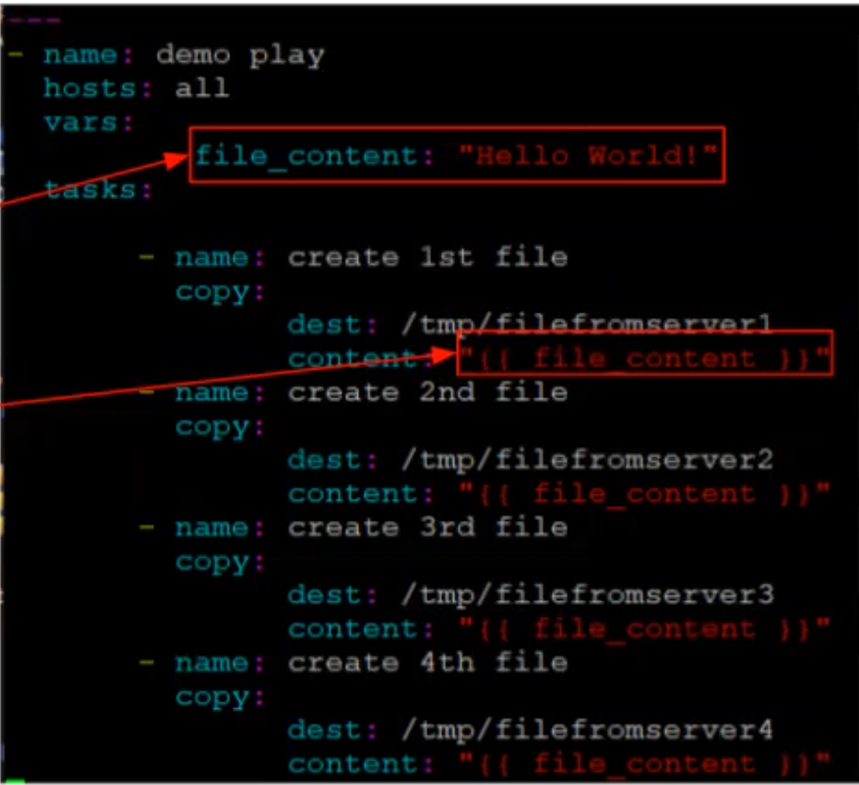
Ansible Variables
MASTER-ACADEMY
Ansible is not a full-fledged programming language, but it does have several programming language features and one of the most important of these is variable substitution.
To define a variable in YAML we use “vars” and use {{ }} curley braces to insert the variable
Here is a simple example of the usefulness of variables in Ansible:
Open the demoplaybook.yaml file and edit it as follows
Execute the demoplaybook.yaml
Variable Declared
Variable Used
DevOps Boot Camp 2021

Slide 27


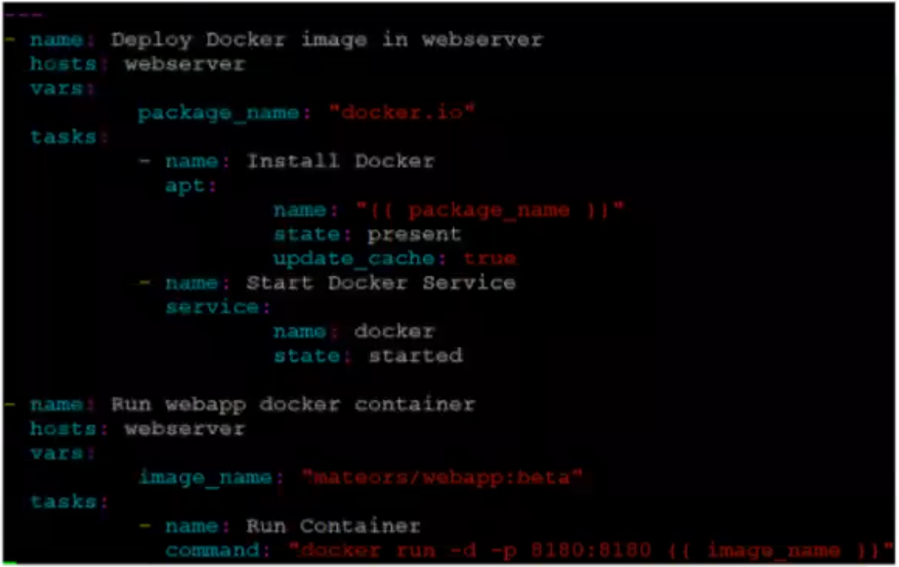
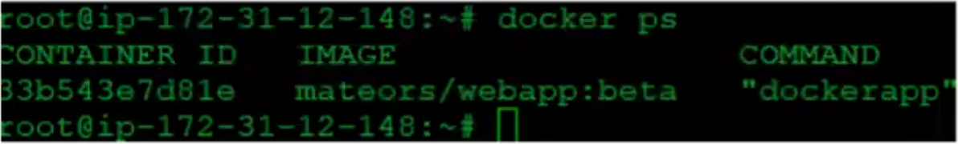
Deploying a Docker Container using Ansible
MASTER-ACADEMY
We can use Ansible to deploy docker containers across several hosts
We will use a docker image from docker hub “mateors/webapp”
Create a new playbook called dockerplaybook.yaml
On the host machine run docker ps
Check on web browser by typing
<host-public-ip:8180/webapp>
DevOps Boot Camp 2021

Slide 28
Thank You!

